Slide 1









Slavery Exploitation Team

Slide 2
Introduction to the team and modern slavery
Perceptions and reality of slavery
Understanding the role of SERAC and the Slavery Exploitation Team
Forms of exploitation and indicators
Case typology and vulnerabilities
How to refer and what we do with partners
National Referral Mechanism
Professional Curiosity
Case studies and data on outcomes

Slide 3
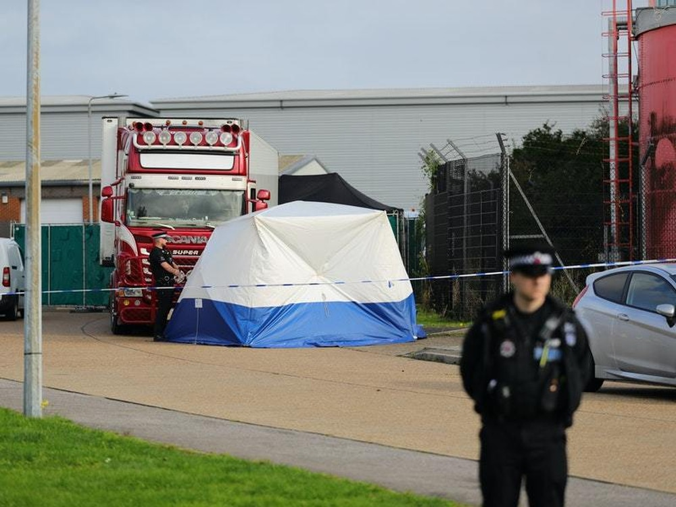
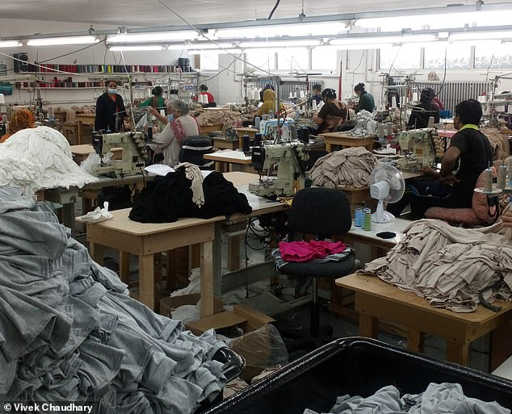
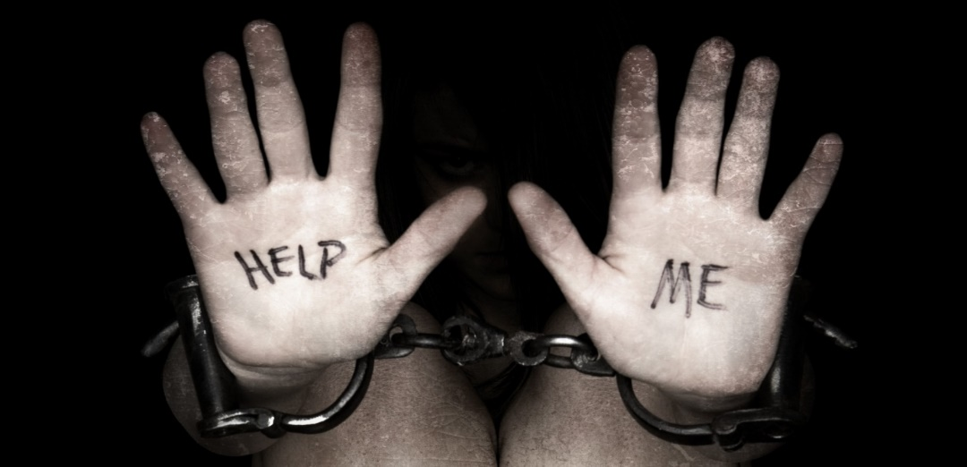

Perceptions and Reality of Slavery and Exploitation

Slide 4
How the Team Operates
Journey of a referral
SERAC – creative discussion, solution focus
Thresholds
Training
Single Point of Contact
Multi agency visits
Strategic role – local/national/global

Slide 5
Sexual / Labour Exploitation
Where/form:
Sex Work
Escort Work
Pornography
Massage parlours
In cuckooed properties
Signs and Indicators:
The person may be 'branded' with a tattoo
Individuals may show signs of physical abuse, including bruising, scarring and cigarette burns
The person may have a limited English vocabulary, restricted to sexualised words
Where:
Restaurants/Takeaways
Car Washes
Agriculture
Nail Bars
Signs and Indicators:
An individual may lack freedom of movement
Lack of protective equipment/suitable clothing to suit the job role
Lack of contract/paid below National Minimum wage/ forced to work long hours
Scared/ intimidated
May be transported to and from ‘work’ locations
Victims may be closely guarded
May have restricted or no access to earnings
The person may sleep in the premise in which they work or be provided with accommodation by the exploiter which is likely substandard and overcrowded

Slide 6
Criminal Exploitation
Signs and Indicators:
Not benefitting or profiting from the crime they have been made to commit
Forced Begging - Groups of adults and children can be moved to different locations daily to do this. They may show signs of abuse e.g. bruises and cuts. Begging may also occur on public transport by a group.
Cannabis cultivation - Usually freedom of movement restricted, may also be locked and kept in the room/location they are cultivating the cannabis
Cuckooing - drug dealers use a vulnerable person's home to sell drugs. Survivors may experience force, manipulation and other means for this to be achieved
County lines - Young people are exploited to transport and sell drugs across county borders - may go missing often or regularly do not attend school
Benefit fraud - Victims are forced to claim benefits which are withheld from them and exploiters make profit. This may be identified through registering large numbers of adult and children at one address, there may be no clear evidence of the proof of relationship.
Forced criminality falls under the category of forced labour and therefore general indicators also apply

Slide 7
General Indicators
Signs of abuse - unkempt, anxious, withdrawn, agitated, have untreated injuries, memory loss.
May appear to be controlled and not able to make their own choices. They may not be familiar with where they are.
Found in overcrowded and unsanitary accommodation (may also be their place of work)
No ID documents
Possess very few personal items and lack basic necessities like good quality clothing, including clothing suitable for work
Not have freedom of movement
Be dropped off/collected for work on a regular basis either very early or late at night
Fearful of authorities – lack of engagement/eye contact, giving differing versions of events
Fearful and concerned for family/loved ones
Most types of exploitation discussed can happen anywhere to anyone

Slide 8
Types of Exploitation 2025
Please note that some cases can have more than one type of exploitation

Slide 9
SERAC
Regular representation from key agencies
Ad hoc case specific representation
Overview of concerns from referrer or caseworker
Additional information from partner agencies
Broader discussion around options, interventions, risk reduction, long term goals
Action planning
Follow up

Slide 10
Risk Management
Housing
Substance Use
Mental Health
Agency Involvement
Immigration Status
Risk of Going Missing/Absconding
Ability to risk assess/access services
Police/Hospital Involvement

Slide 11
Outcomes
Supporting police investigations
Feed into National Referral Mechanism referrals
Appropriate accommodation sourced
Safety planning – POI, safe and well checks, lock changes, emergency accommodation, flags on systems
Capacity assessments
Safeguarding/other agency referrals
Identification and referral into most appropriate advocate
Support to return to home country (when desired)
Continuation of monitoring – CPOs, NPT , POW, housing managers
Civil actions – prohibition orders, injunctions

Slide 12
Vulnerabilities 2025
Please note that most cases have more than one identified vulnerability.

Slide 13
Issue
Parties, excessive visitors, drug use/dealing, sex working
Perception
High level ASB
Reality
Cuckooing/County Lines
Unkempt property
Tenancy issues/breaches, lack of access
Vulnerable tenant lost control of property
Anger/aggression towards professionals
Non-engagement
Fear of authorities. Under duress to get rid of them
Environmental issues, excess waste, overcrowding, numerous different people coming and going
Irresponsible tenants, subletting
Human trafficking halfway house/slave labour/hot bedding
Deterioration in personal care and demeanour
Mental health, substance misuse, poor living standards
Lack of access to appropriate facilities, food, social interaction
Drug use, theft, anti-police, criminality
Criminal history/convictions
Offending through choice
Criminally exploited – under duress
Cuckooing
Money issues, petty theft, begging
Not prioritising spending/poor money management
Financial exploitation
Not answering calls and letters or attending appointments
Non-engagement
Restricted liberties – phone taken, under threat, cannot leave property/situation
Substance misuse
Lifestyle choice
Self medicating trauma or fed substances to be controlled
Sex working
Lifestyle choice
Sexual exploitation/trafficking

Slide 14
Referral Sources
Local Authority:
Neighbourhood safety officers
ASB team
Environmental Health
CP Intel
Licencing
Trading standard
Adult Safeguarding/MASH
Safer Housing
Complex Persons/Vulnerable person Panel
Leaving Care
Housing Providers:
Local Authority housing
Metropolitan
NACRO
Places for People
Nottingham Community Housing Association
PA Housing
Housing 35+
YMCA
Obvious linked agencies:
Police
MARAC
Gangmaster Labour Abuse Authority
Notts Fire and Rescue
Non Government Organisations:
POW (prostitute outreach workers)
Jericho road
Salvation Army
Food Banks
Women's aid/JUNO
Equation
Health:
NHS Trust hospitals
Community Forensics Teams
Mental Health services
Community nursing teams
GPs
Substances support services
Other
Department of Work and Pensions (DWP)
Framework
Probation
This is not an exhausted list

Slide 15
Consent
Consent is not required for referrals to the SET or SERAC. If someone is currently being exploited of held in slavery, there are likely to be elements of coercion and control. Should consent be sought to refer, the potential victim may disclose this to their exploiter, placing them at risk of harm or trafficking.
The legal basis under which such information can be shared for the purposes of safeguarding is covered mainly through:
Prevention and detection of crime (s.115 Crime and Disorder Act 1998)
To protect victim or others from serious harm or matter of life or death (GDPR art.6 & 9)
For a public task (vital interests - usually bringing perpetrators to justice)
Right to be free from torture or inhuman or degrading treatment (Human Rights Act, Articles 2 & 3)
Prevention of Abuse and Neglect (The Care Act 2014)
There may be other legal basis on specifics of individual cases (FGM, forced marriage, child protection etc).

Slide 16
The National Referral Mechanism
(NRM)
Only First Responders’ can refer into the NRM. In Nottinghamshire local First Responders include: Police, Local Authorities, Gangmasters and Labour Abuse Authority, Salvation Army, Migrant Help, Barnardo’s, National Society for the Prevention of Cruelty to Children (NSPCC).
The NRM is a framework for identifying and referring potential victims of modern slavery and ensuring they receive the appropriate support. It offers:
Safe accommodation (where needed)
Practical help and advice
Interpretation and translation services
Financial support
Healthcare to meet physical, emotional and mental health needs
Specialist legal advice
Education for school-aged dependent children
Transport to important appointments
Future-planning support
If you suspect Modern Slavery, trafficking or exploitation always contact the Police, Social Care (if health and care needs are established) and refer to the Slavery Exploitation Team.

Slide 17
Remember
Follow your instincts
Your actions matter
Professional curiosity saves lives
Make safeguarding personal – put the person at the centre of what you do
Time is always precious
You are accountable as a professional
You have to live with the consequences of your decisions

Slide 18
Contact Details
MSVP@nottinghamcity.gov.uk

